Slide 1
Interpreting Measures of spread
How do we use range and Interquartile range to analyse spread in data?

Slide 2
Interpreting Measures of spread
When given a set of data, we need to be able to analyse the data, using our measures of spread.
We have learnt about 5 number summaries, which allow us us to find the Minimum, Maximum, Median,
Q₁ and Q₃.
The maximum score take the minimum score is called the RANGE. This shows us the overall spread of the data.
Q₃ – Q₁ gives us the INTERQUARTILE RANGE (IQR). This gives us the interquartile range – this is the middle 50% of the data.

Slide 3
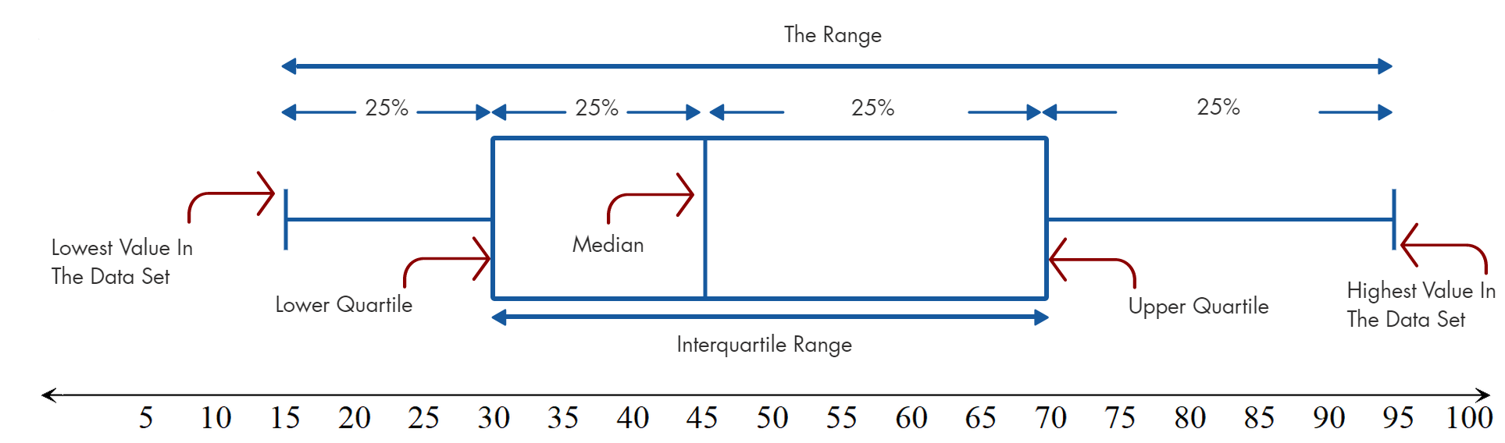
Interpreting Measures of spread – Comparing the two
Comparing the range to the IQR gives us the ability to make judgements about the data.
Talking between your pairs, brain storms the benefits of looking at the range, in comparison to the IQR.
Which do you think would be a better comparative statistic? Why?
The benefits of comparing these two sets of data is that the IQR gives us a overview of the middle 50% of the data, without OUTLIERS being included. The range gives us the two extremities, but could contain outliers which will throw out our score.

Slide 4
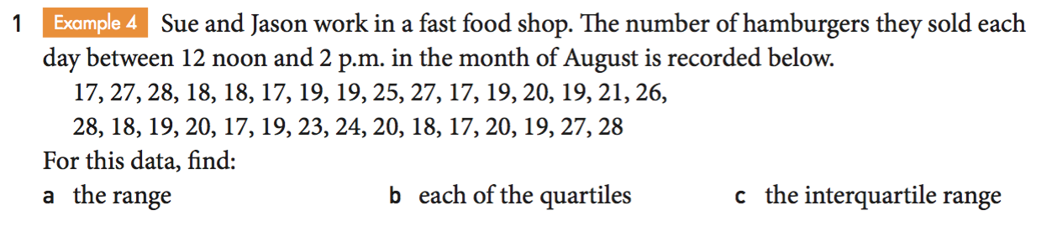
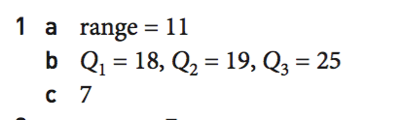
Practise

Slide 5
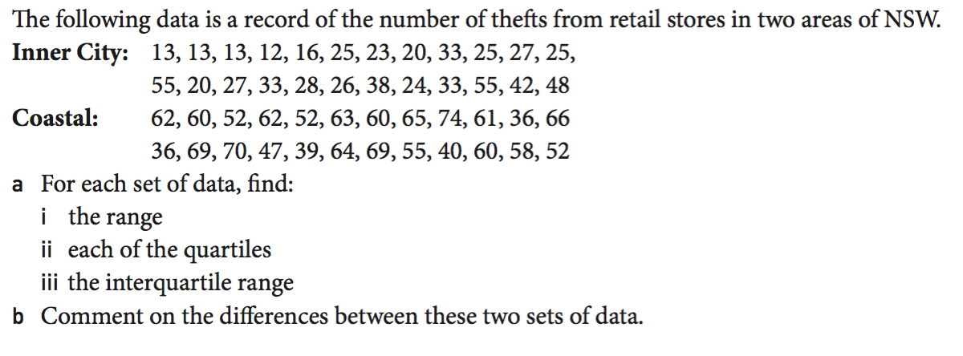
Practise

